Slide 1
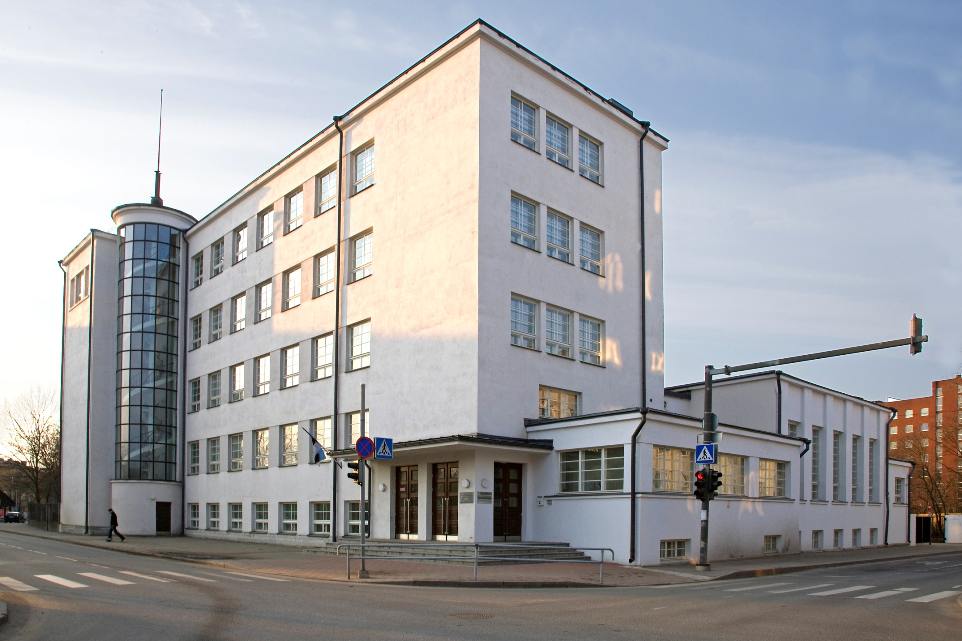
TKVG – Brief history
Dedicated to our teachers, students and graduates of our school
By “Leader” History club
2012

Slide 2
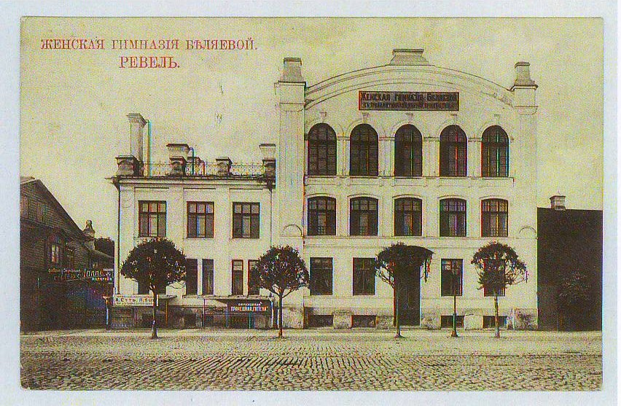
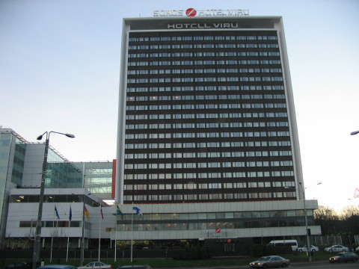
1923 -1940
History of our school began in 1920’s. Gymnasium was formed in 1923 by the name “Tallinn City Russian Gymnasium”
The school was located at Narva st. 6а.
Today, the “Viru” hotel is located on the place of our former building.

Slide 3
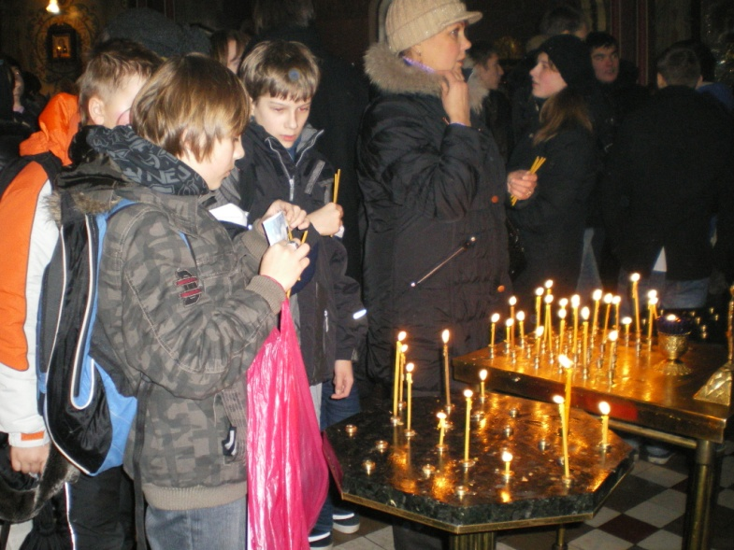
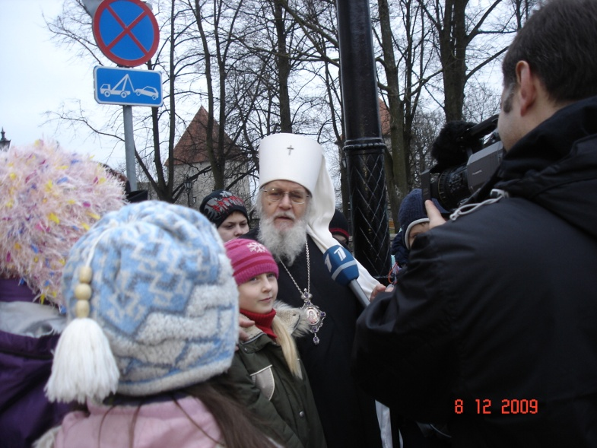
Birth of traditions
Lessons began on the 30th of August 1923. On this day the Orthodox Church commemorate Alexander Nevsky, therefore the day of commemoration (6th of December) was chosen as our school's holiday
This tradition is now restored, and that is why the 6th of December is now:
TKVG Gymnasium Day!

Slide 4
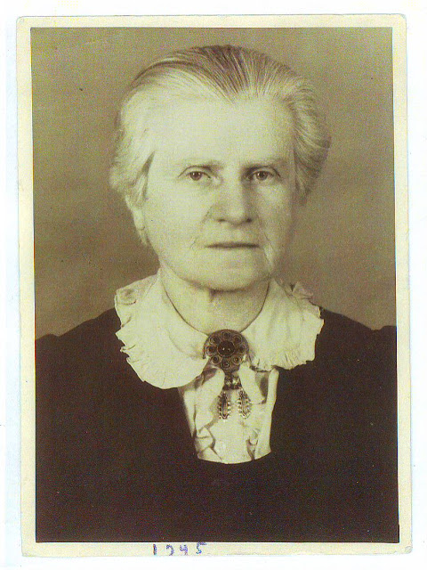
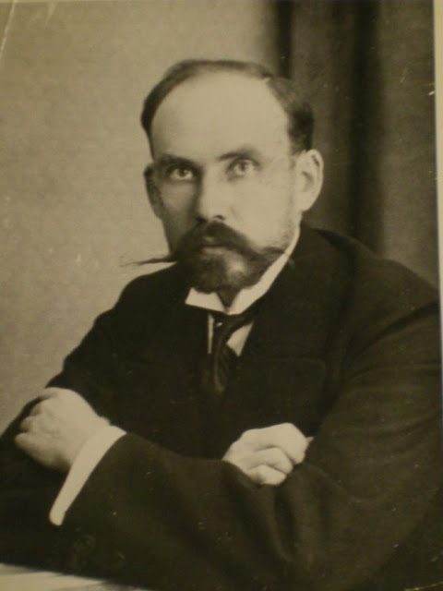
1923 -1940
The founders of our school were their first Headmasters: Grigory Barkhov, Alexander Peshkov and Director of Studies Zinaeeda Dormidontova

Slide 5
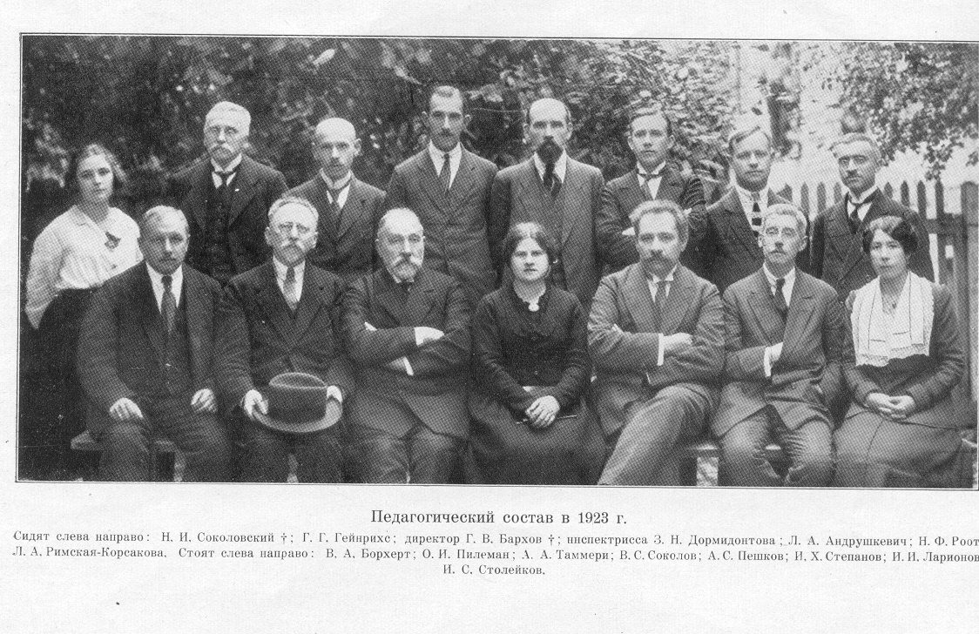
1923 -1940
Council of Teachers in 1923 consisted of 24 people, most of the teachers were men who had exceptional university degrees. Number of students on the opening year were 402. In school studies were seperate: boys studied maths and science, girls studied humanitarian subjects. Following 10 first years, 22% of girls and 65% of boys continued their studies in colleges and universities.

Slide 6
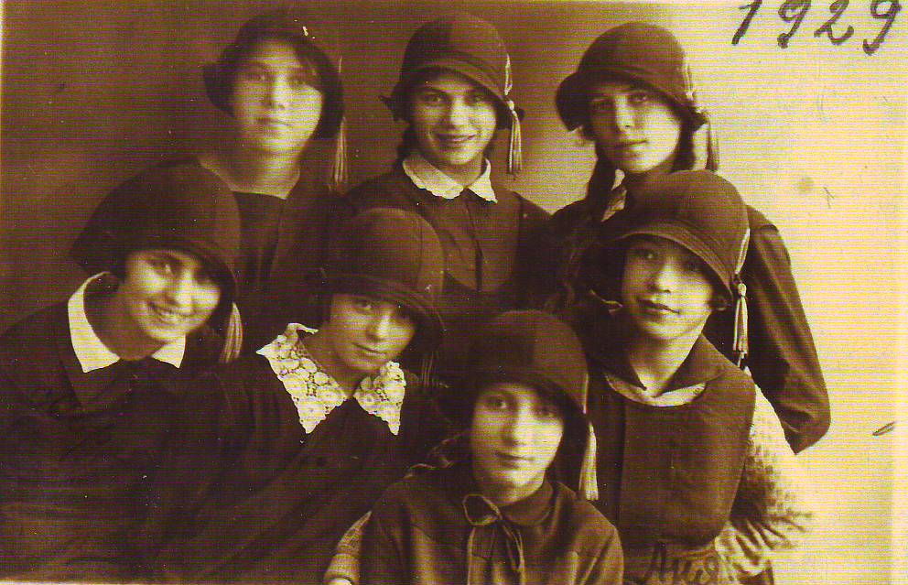
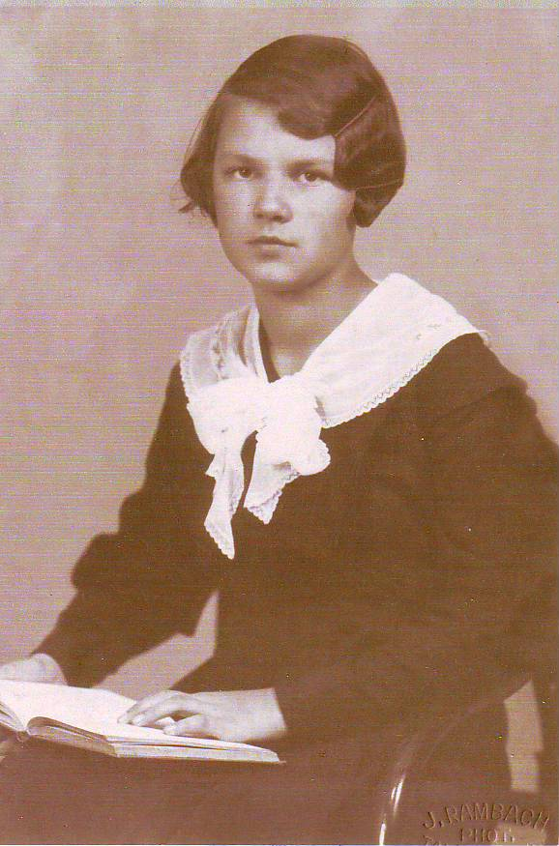
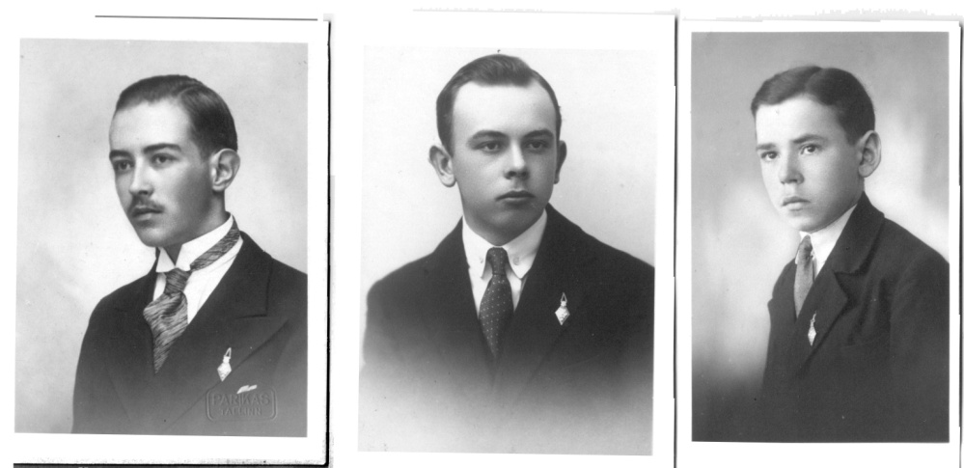
Birth of traditions
Gymnasium had its own uniform and symbol

Slide 7
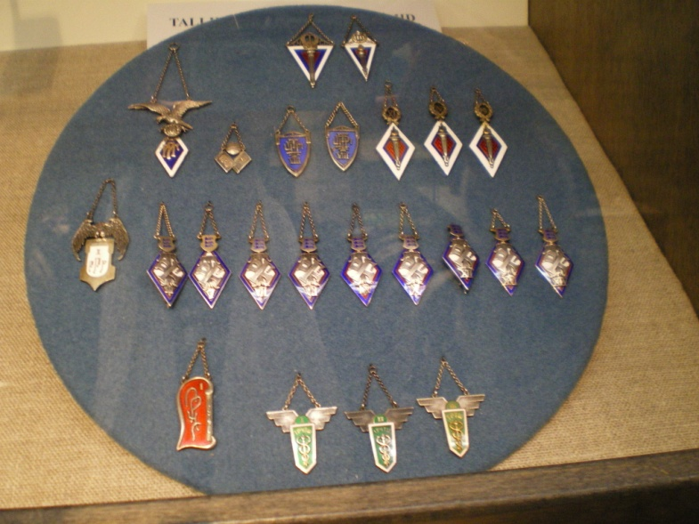
Birth of traditions
In 1926 "Eesti-Lipp" finished a flag for our school, which cost 4000 marks. In the beginning every class had its own symbol, but the best symbol was chosen that of Margaret Lenzin. That symbol had become TKVG's visiting card. Gymnasium had its own hymn, which was written by student E. Pitka and music teacher I.H.Stepanov.

Slide 8
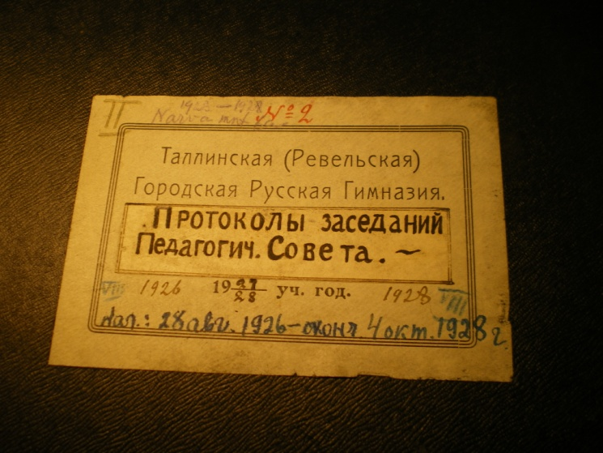
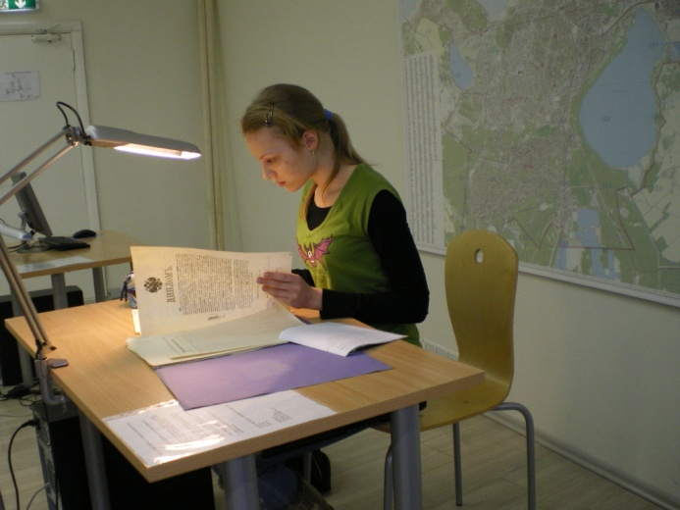
From TKVG's Council of Teachers’ protocols.
In TKVG students printed their own journals by themselves.
September 2nd 1923: Council of Teachers has allowed for students from 4th Form to publish journal "Zveno" under Peshkov's supervision.
September 23rd, 1925: Students from 4th Form to publish "Gust" under Andreev's supervision.
1927-1928 "Our life" journal under Prokhorov's supervision. In all these journals student's storytales and poetry was published.

Slide 9
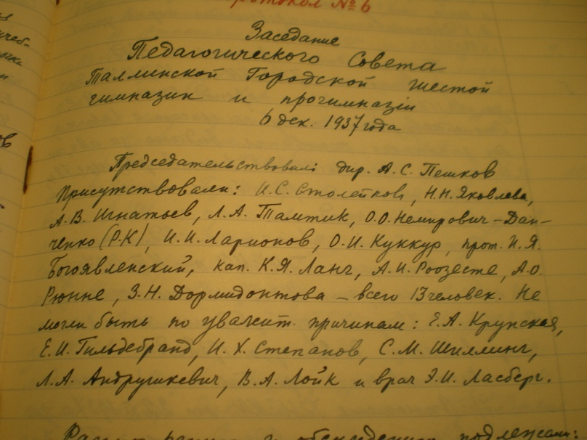
From TKVG's Council of Teachers’ protocols.
TKVG ran some clubs. Some of them:
September 6th 1923. Teachers' council allowed to open Science club under Geinreichs' supervision.
There were also pottery, art, crafting and needlework club
January 14th 1925: Teacher's council assigned Peshkov to create a scout's division in our school

Slide 10
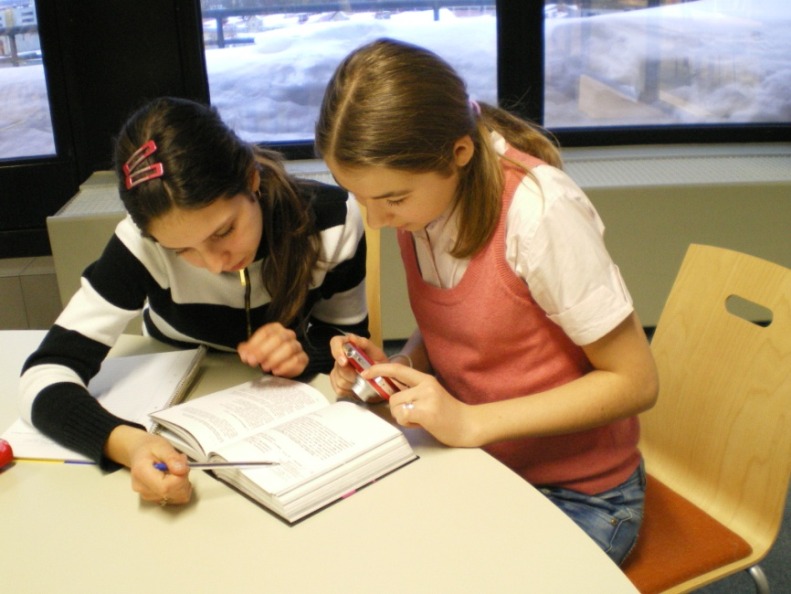
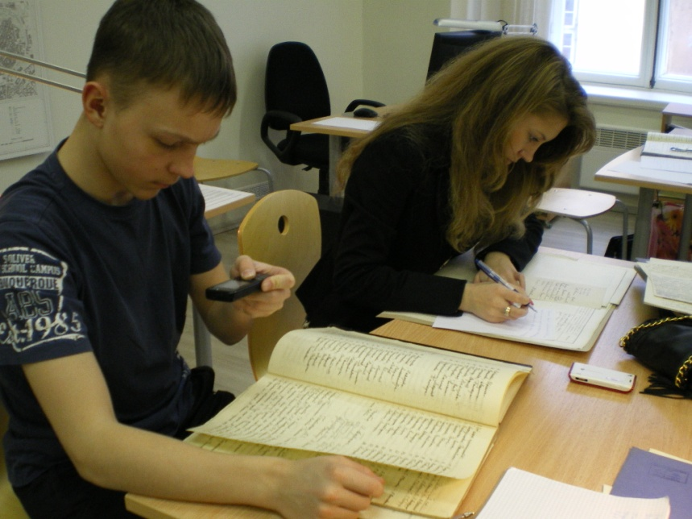
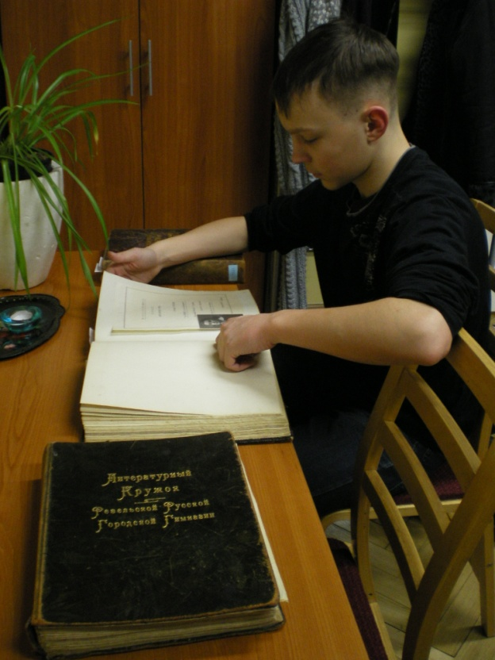
From TKVG's Council of Teachers’ protocols.
But the most popular was the literature club, which was opened in September 1923.
Since then Friday had become a day of noisy gatherings, and the club's spirit was a long-term literature teacher Vladimir Sokolov

Slide 11
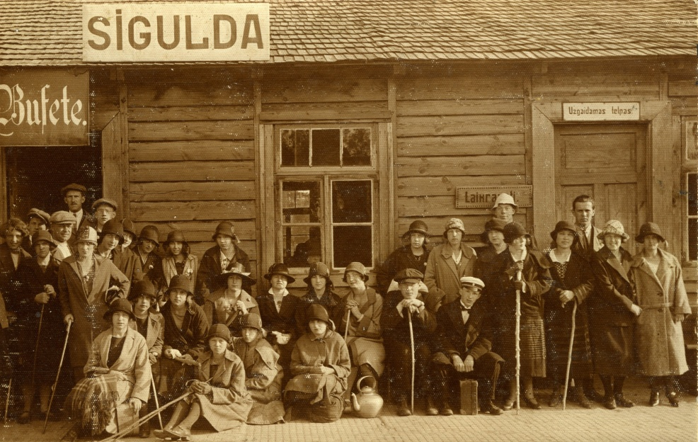
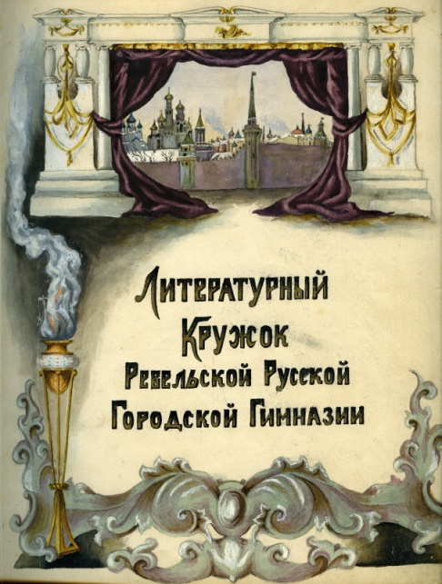
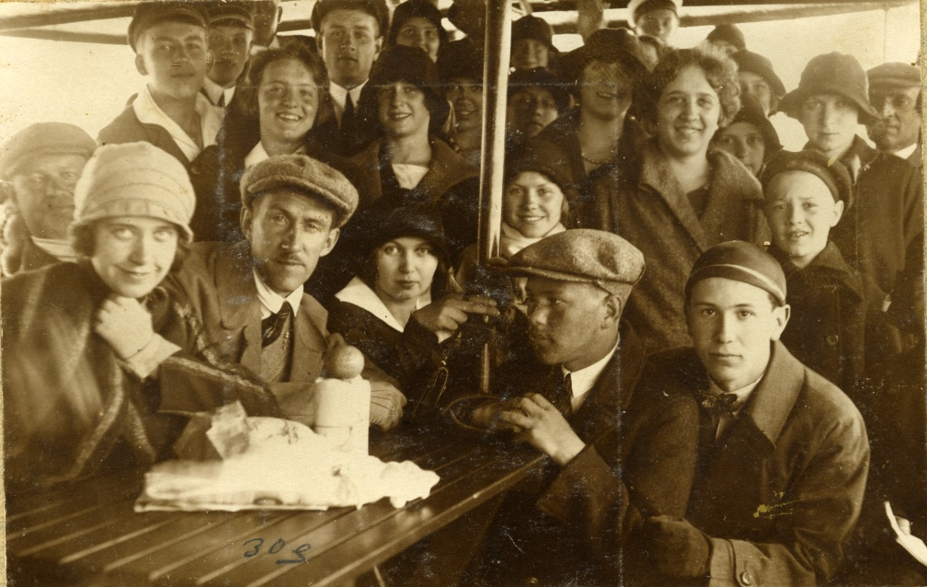
From TKVG's Council of Teachers’ protocols.
In summer months club members along with teachers journed on excursions in Estonia, Latvia, Finland, Chekhoslovakia, Austria.

Slide 12
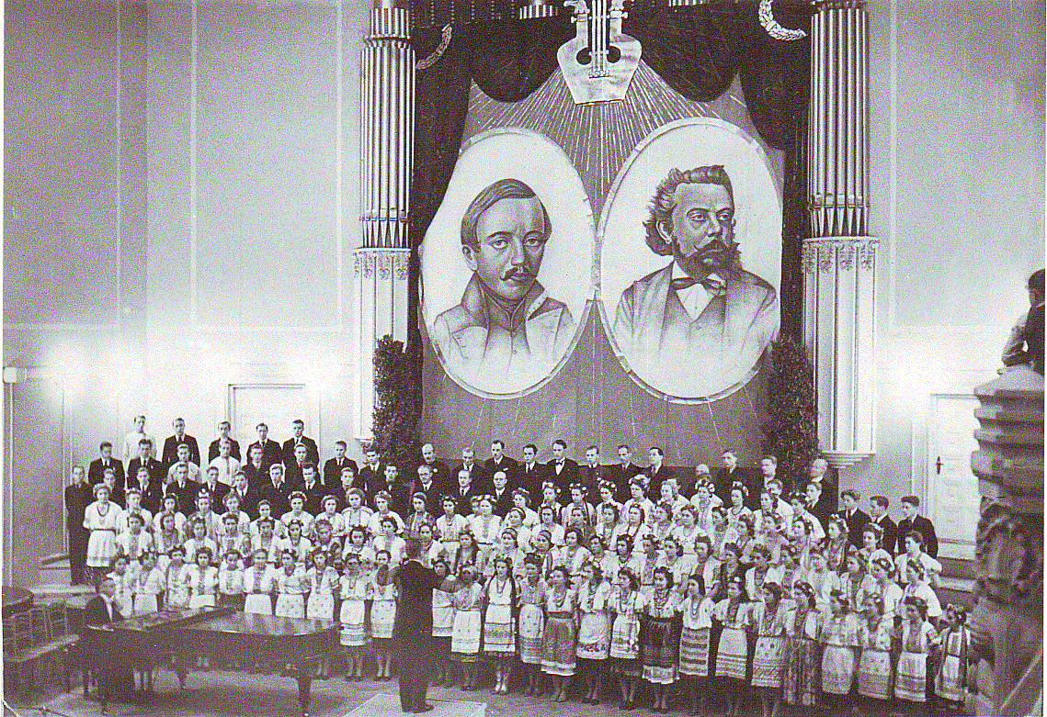
From TKVG's Council of Teachers’ protocols.
There were also a variety of musical clubs: balalayka players club, brass band club, gymnasium choir under Stepanov's supervision.
The choir had contested on Russian holidays, School singing holidays, gymnasistic evenings and spectacles every year.

Slide 13
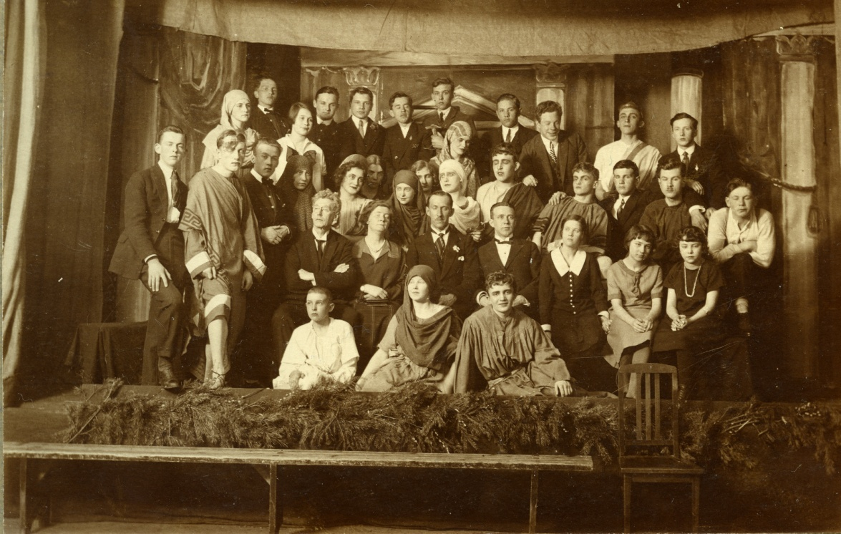
From TKVG's Council of Teachers’ protocols.
The school had its own theater. Performances were played with the help of Russian Theater's best artist and director Lyev Eberg. In addition to this, the performances which were played were very complex.
1924 - A. Block - "Rose and Cross"
1925 - R. Tagor - "Postal"
1926 - A. Maykov - "Two lifes"
1929 - E. Rostan - "Princess Grez"

Slide 14
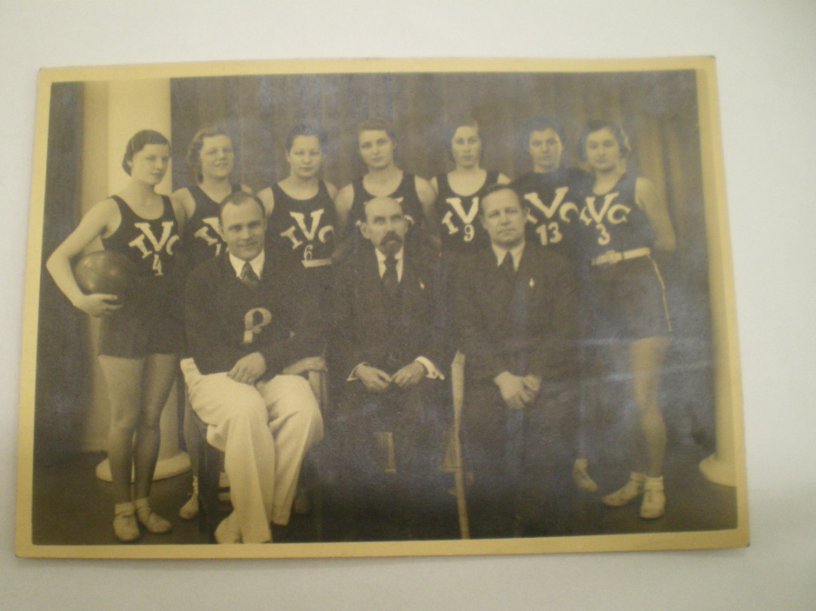
From TKVG's Council of Teachers’ protocols.
But school was especially proud of it's sportsmanship.
1930 - The basketball team became the Champions of Baltics
1930-32 - There was no match in Estonia for TKVGs Lightweight athletics team
Guys participated in France, Switzerland, Chekhoslovakia, Poland and Latvia

Slide 15
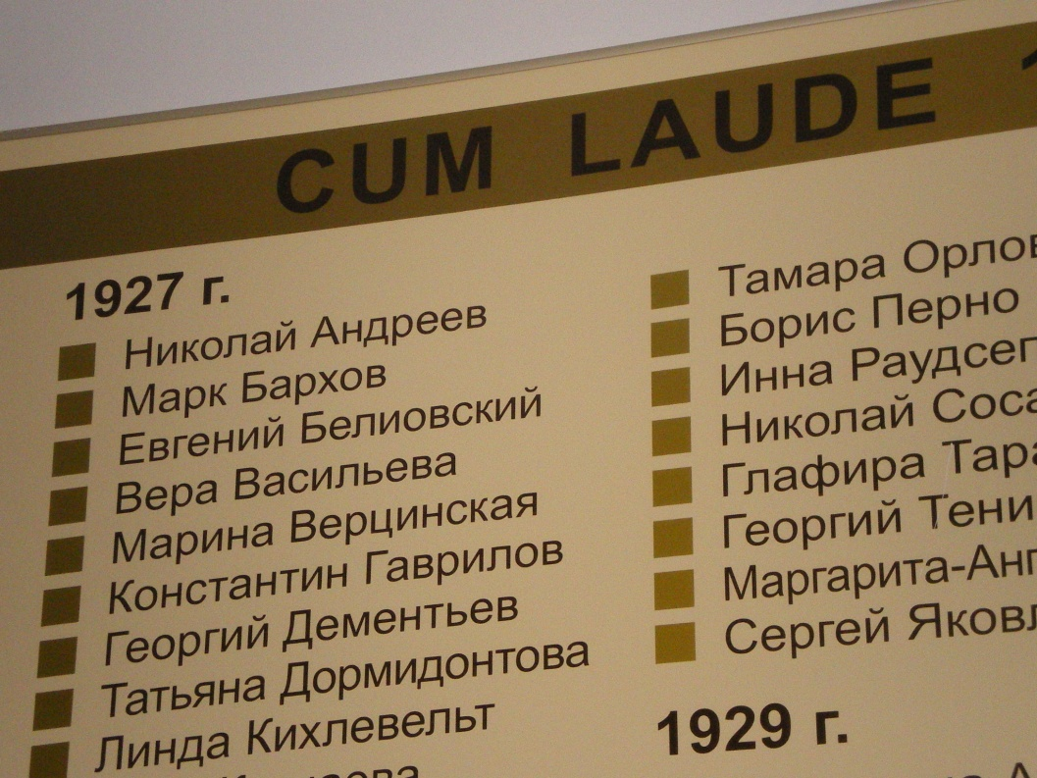
From TKVG's Council of Teachers’ protocols.
Some unique school drills:
7:50 - Those who were late were to be signed up for additional Maths classes with school's Headmaster
8:00 - Morning prayer
Girls were to bow and kneel before superiors
Best of the students were granted with CUM LAUDE (“With Excellence!”), back then there weren't gold medals.

Slide 16
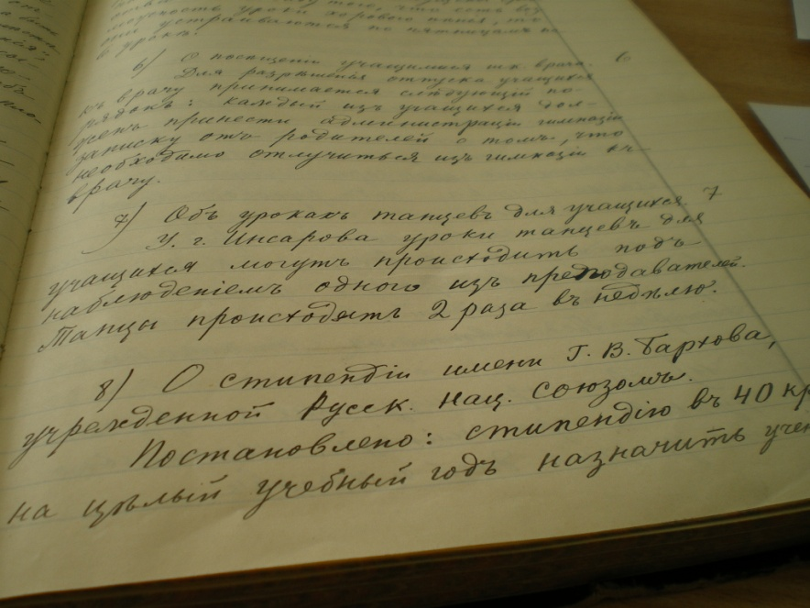
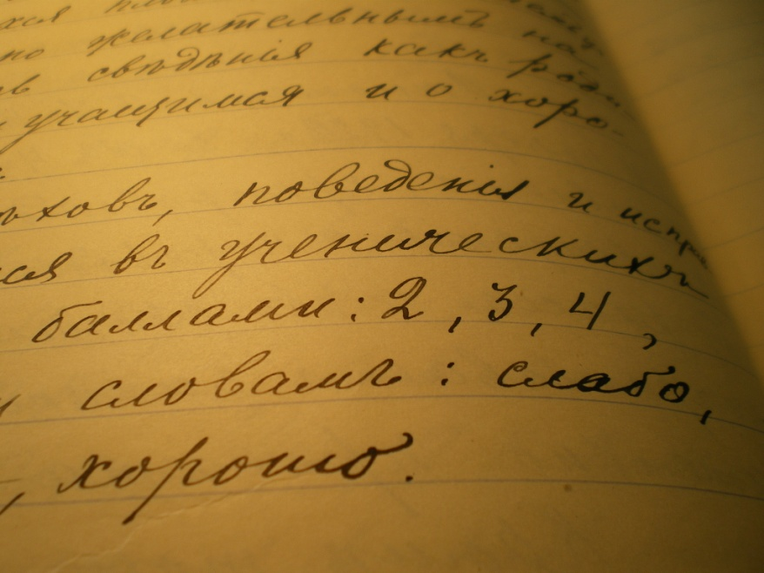
From TKVG's Council of Teachers’ protocols.
Some unique school drills:
Till 1934, grades were given out on a 3-point scale, there weren't one's and five's (Simply "Good, satisfactory, low")
1928 - After first headmaster's death, Russian national society established Barkhovs scholarship. First scholarship was granted to 2nd Form student Grigory Chernyavsky

Slide 17
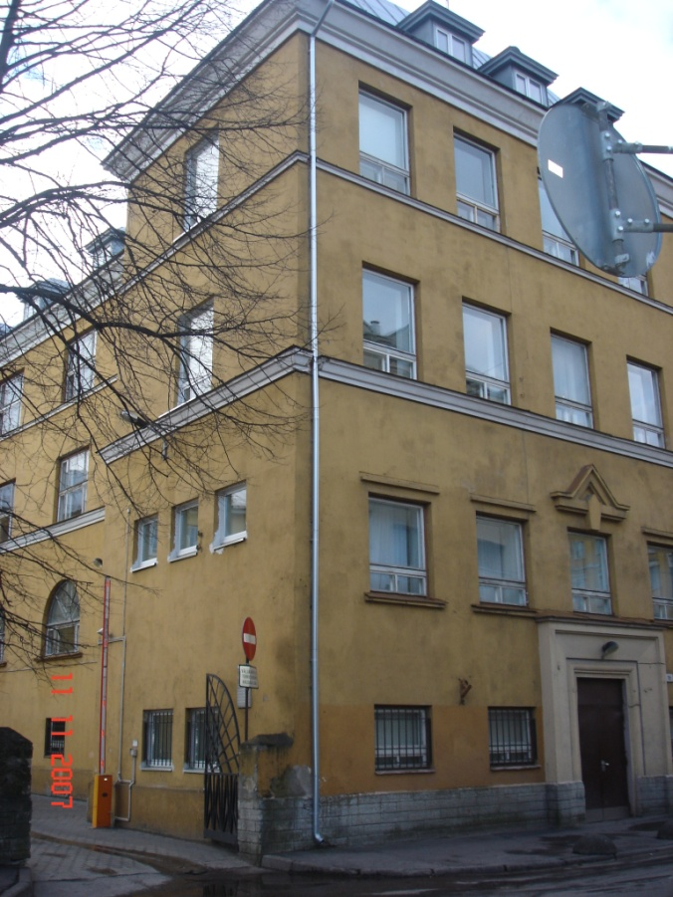
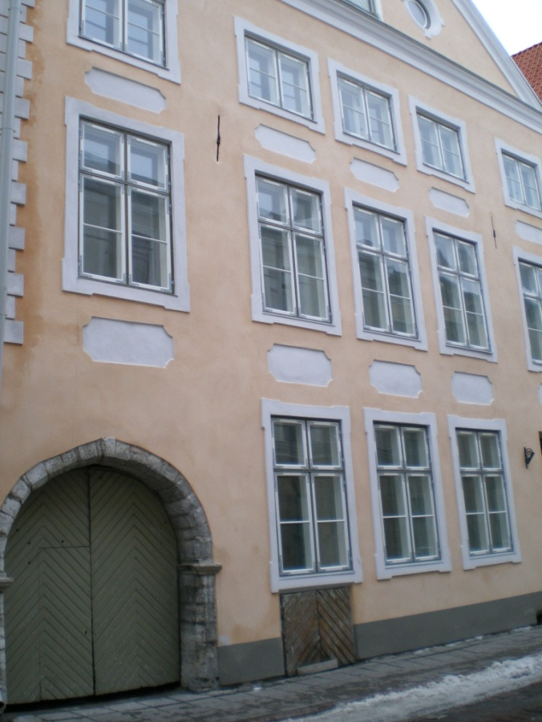
From TKVG's Council of Teachers’ protocols.
The influx of students was so big, that our previous building was not enough, so our school had to rent rooms in other places (located at Karu st 16, Pikk st 69)

Slide 18
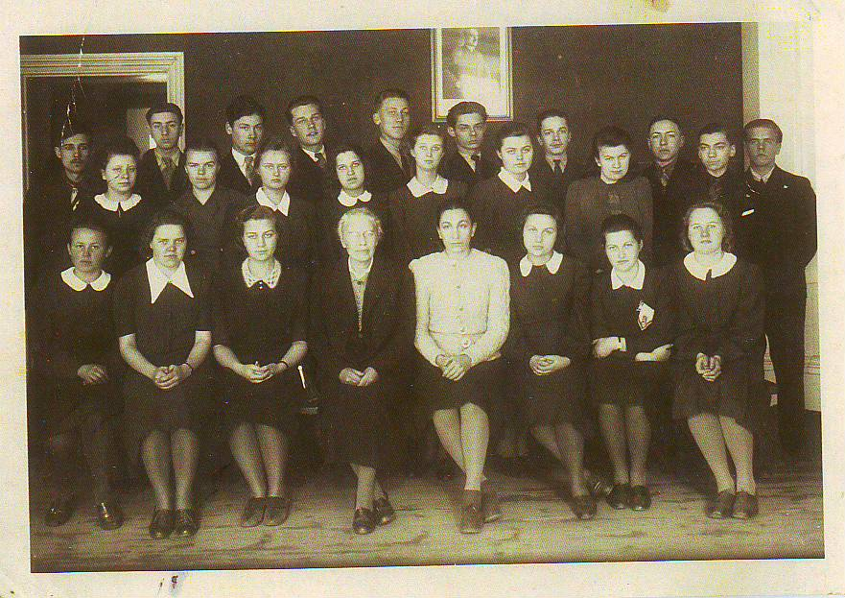
1941-1944
Even during German occupation 1941-44 our school continued to work.
This was a great merit by then-headmistress Margharet Lenzin. She did everything she could to preserve our school.

Slide 19
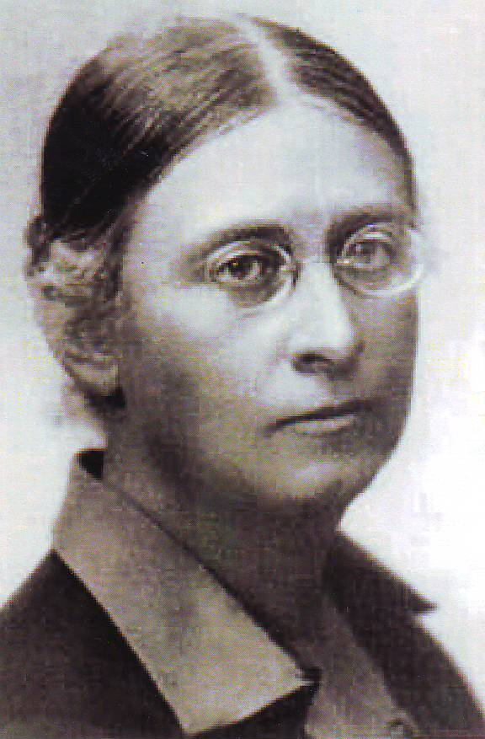
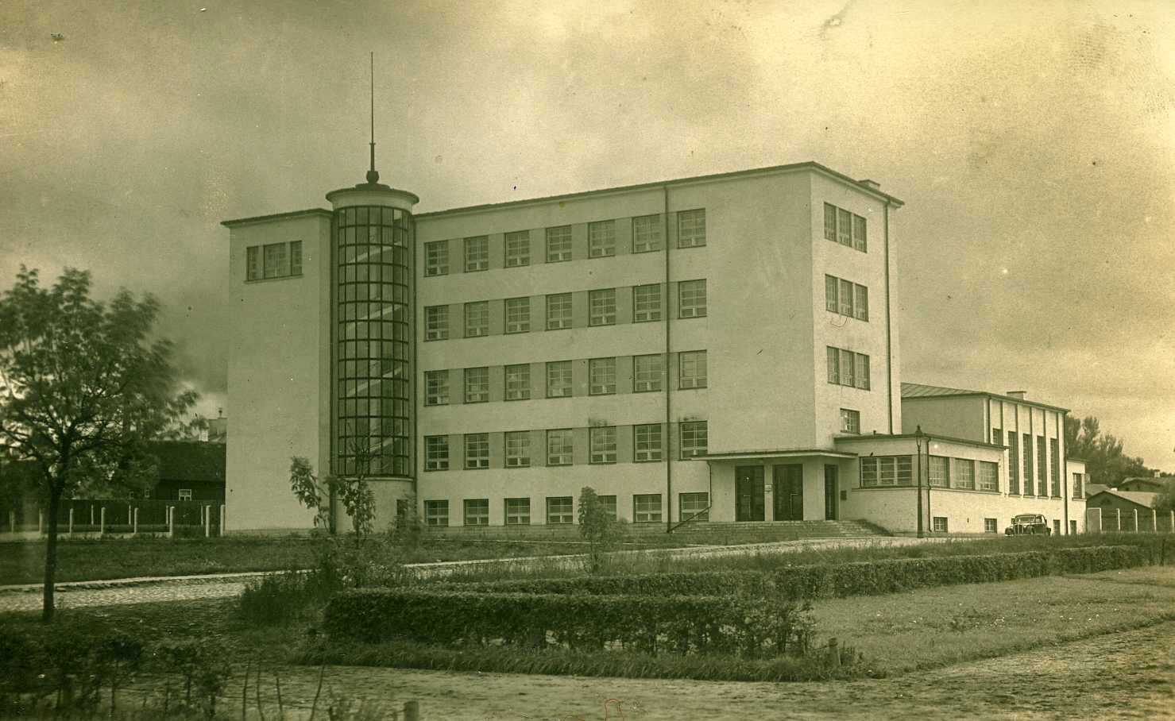
1945-1960
After the Second World War our gymnasium moved into a new building, which was formerly owned by Private Lender Women Gymnasium at Kreutzwaldi 25 st, where we have been located since.
Gymnasium was renamed into 6th High School (1944-1998)

Slide 20
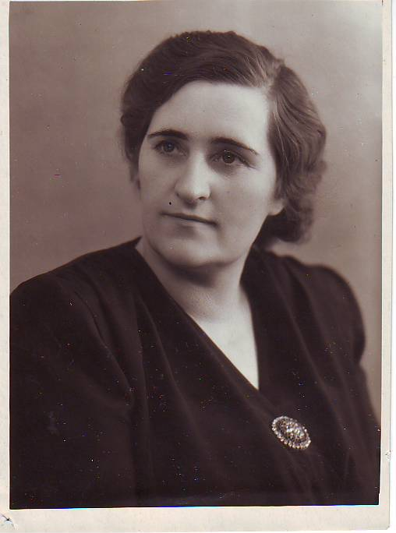
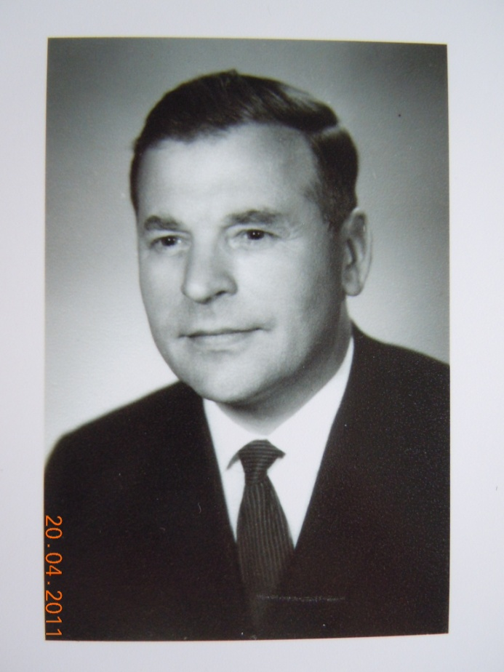
1947 – 1990
1945-1990 - New Headmasters, Valeria Anton and Grigory Zotov did everything to make our school greatest in Tallinn.
After the war a pioneer group was formed along with komsomol organisation. In the pioner camp "Artek" Irina Kopti was assigned.

Slide 21
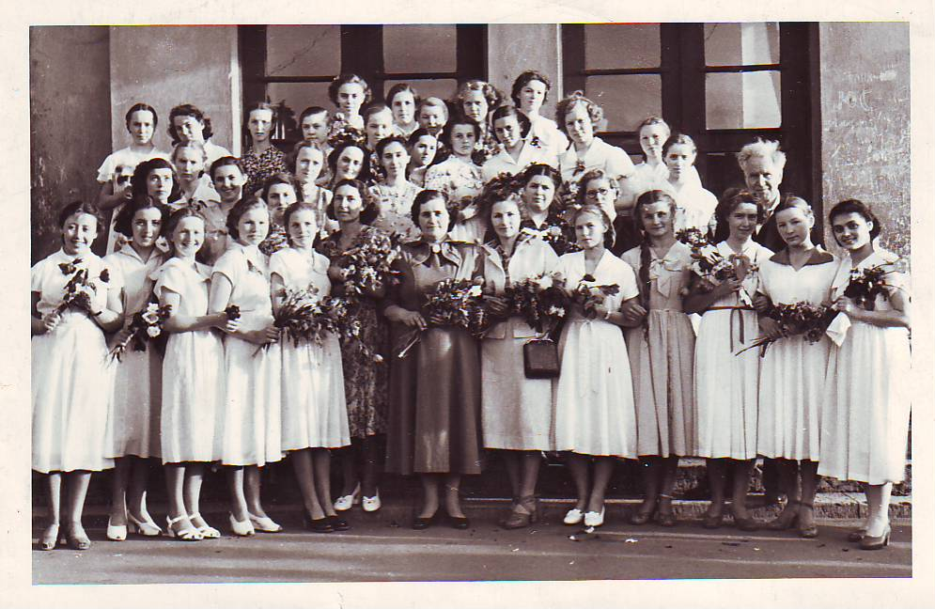
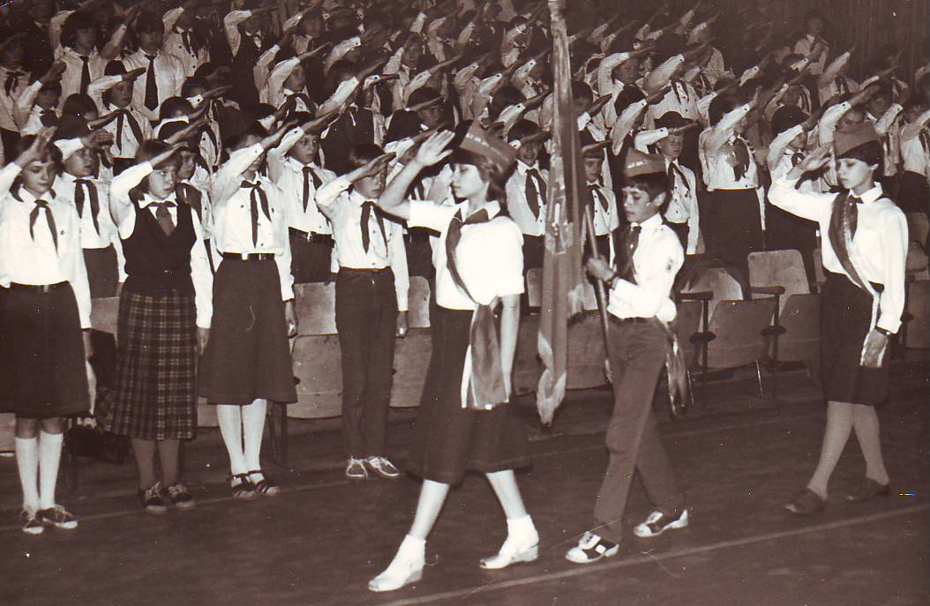
From school chronicles:
In "young naturalist" competition our school was the best. The best "International Squad" club in Tallinn was also ours.
Sanitary post of "Zarnica" took 1st place. Regularly gathered wastepaper. Participated in pioneer parades of May 19th every year.

Slide 22
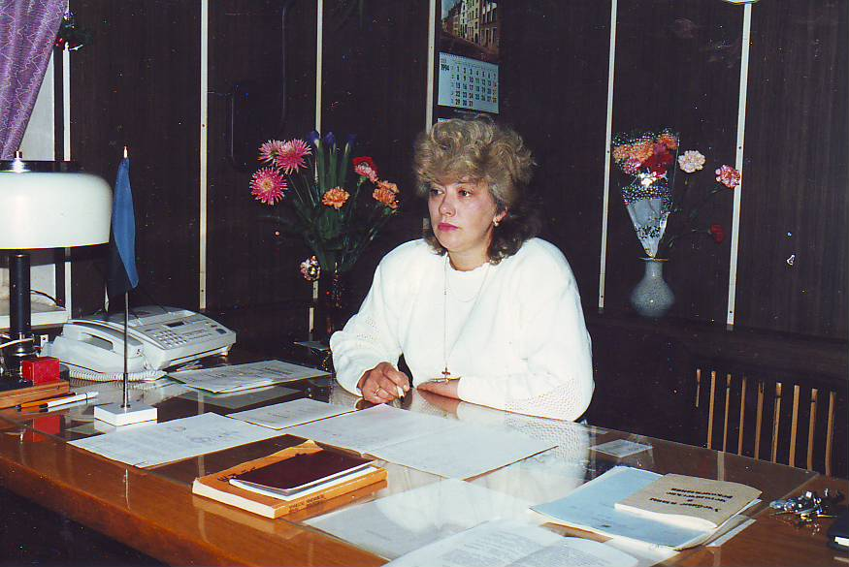
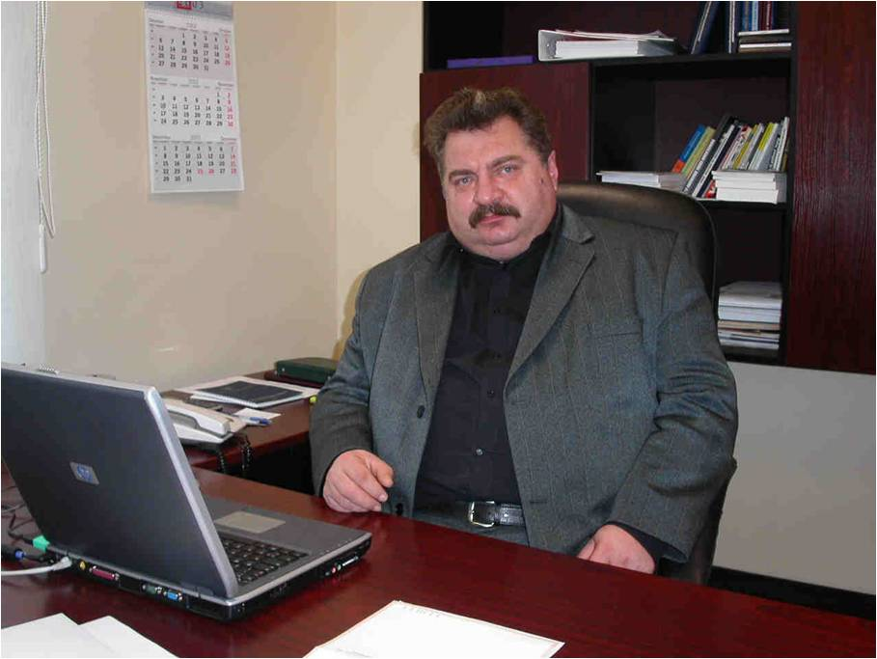
1990-2009
The beginning of the 1990s was a harsh time. Previous educational system in Estonia is collapsing. Pioneer and komsomol organisations are in past now. Estonia becomes an independent country. Nonetheless, new headmasters, Irina Romashechkina and Vyacheslav Gussarov, not only did they preserve our school, but they also enhanced the credibilty of our school throughout Tallinn. New reforms brought to school's new name
Since 1998. - Tallinna Kesklinna Vene Gümnaasium

Slide 23
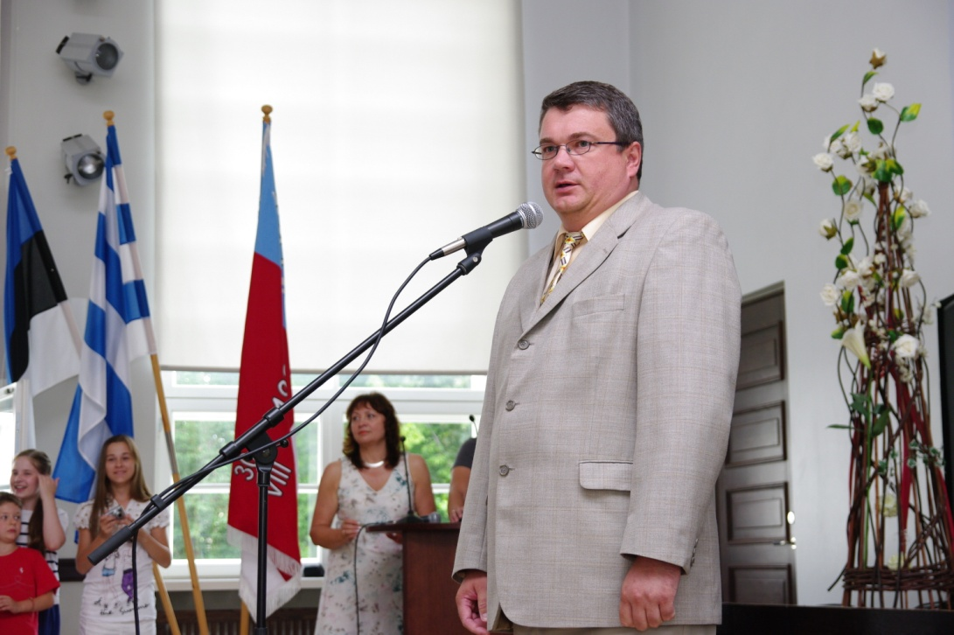
2009-2012 гг.
2009 - in TKVG works new administration under Sergey Teplov's reign. A lot of gigantic reforms are enacted, which have brough to a colossal success.
2012 - Not only are we best in out-of-school activities, but we also are on the 12th place among Estonian Top schools according to the exam results.

Slide 24
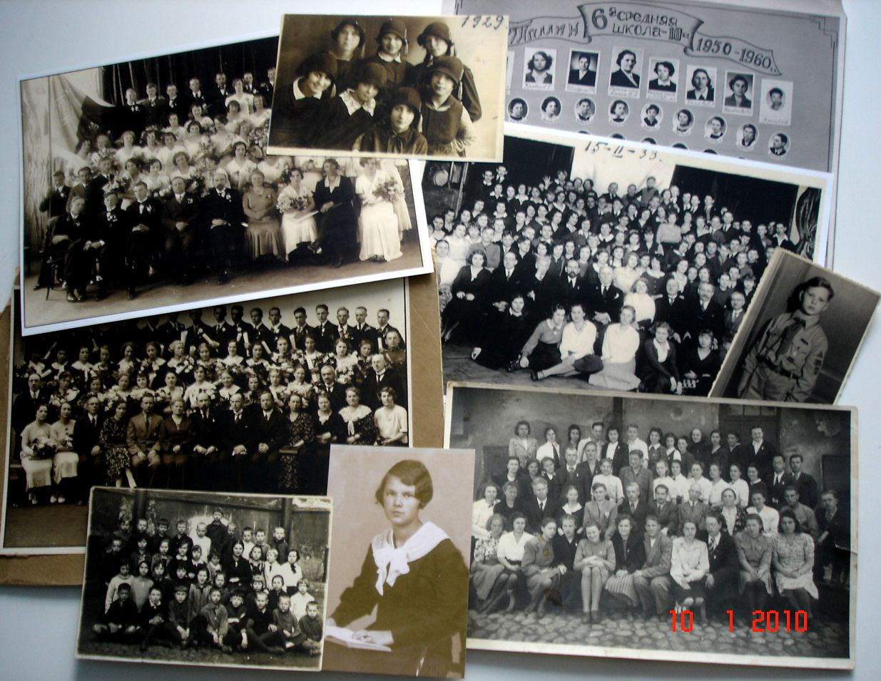
Dear students, teachers, parents! Take care of our school! Be proud, that you studied in TKVG and that this time left a good mark in your life!

Slide 25
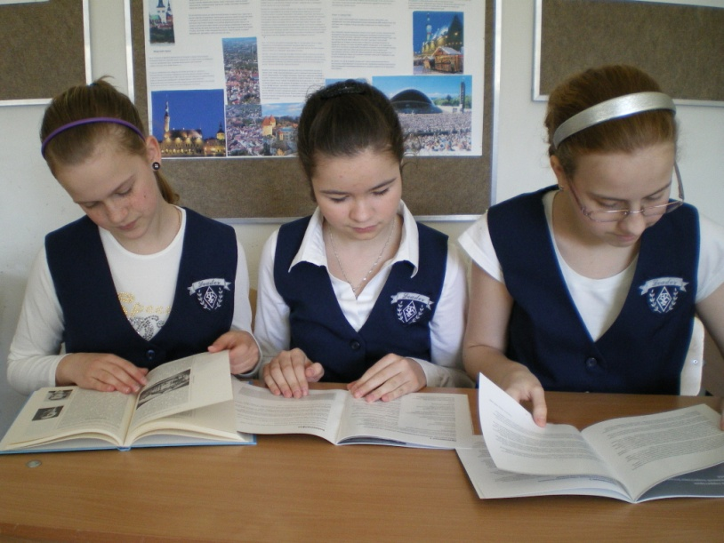
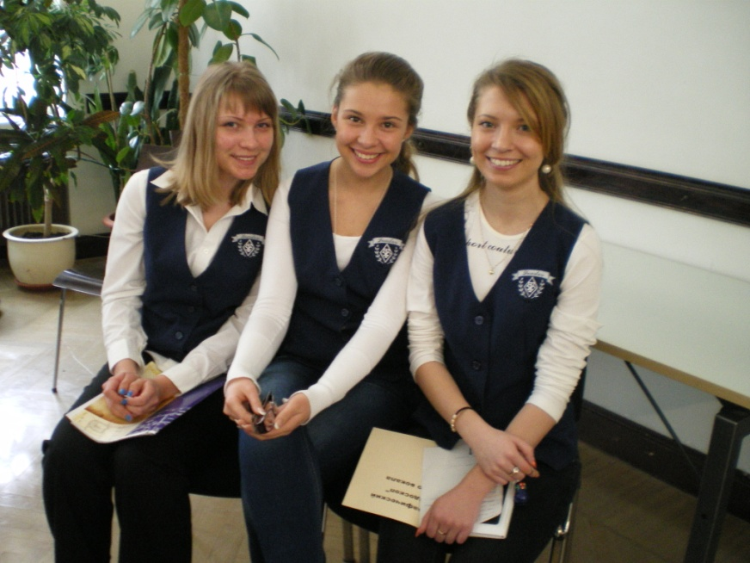
Thanks to the guys of "Leader" historical society for working on the Tallinn archives: Catherine Kassapova Ksenia Andreyeva Anzhelika Danilova Maksim Savelyev Darya Balryura Tatyana Krivobokova Evgeniya Barsuchenko DIana Yakobutsa Translation: Ruslan Bolkvadze

